Slide 1
Java Basics

Slide 2
About Java
Java is a class based Object oriented Language
Support all OOPs concepts like polymorphism, abstraction, Encapsulation and inheritance
Java uses automation Garbage collection. No need to clean up memory when objects are no longer used.
All the code in java are written within a class and everything is an Object.

Slide 3
JDK, JRE and JVM
JVM – Java virtual machine. It provides an environment where Java bytecode can be executed.
JRE – Java Runtime environment. It is a set of tools used for developing Java applications. It is the implementation of JVM and physically exists.
JRE
JVM
Set of libs
Other files

Slide 4
JDK, JRE and JVM
JDK – Java development kit is a software development environment used to develop java application and applets.
It consists of JRE + development tools
The JDK contains a private Java Virtual Machine (JVM) and a few other resources such as an interpreter/loader (java), a compiler (javac), an archiver (jar), a documentation generator (Javadoc), etc. to complete the development of a Java Application.

Slide 5
JDK
JRE
Development tools like
Javadoc,javac, jar etc
JVM
Set of libs
Other files

Slide 6
JVM Architecture
JVM performs the following operations
a. Loads code
b. Verifies code
c. Executes code
d. provides runtime environment

Slide 7
JVM Architecture
Class Loader
Class area
Heap
Stack
PC register
Native method stack
Execution engine
Native method interface
Java native libs

Slide 8
JVM Architecture
Class loader – Used to load class files
Class area – stores pre-class data such as constant pool, method data, method code
Heap – Objects are allocated
Stack – Local variables and partial results
Program counter register – Address of JVM instruction currently being executed
Native Method stack – contains all native methods used in the application(Methods written in other languages)
Execution engine – executes the instructions
Java Native interface – Provides interface to communicate with applications written in other languages

Slide 9
Code Structure
package DriverScript; Package- Collection of classes
import java.io.File;
import java.io.FileInputStream; Import Statements
import java.io.FileOutputStream;
Class Declaration
public class MasterScript extends MasterScriptHelper
{
public void main(Object[] args) { Main method
int counter = 0; Variable
counter = incrimentCounter(counter);
}
private int incrimentCounter(int counter){ Method
counter = counter+1;
return counter;
}
}

Slide 10
Object And Classes
Object - Objects have states and behaviors. Example: A dog has states-color, name, breed as well as behaviors -wagging, barking, eating. An object is an instance of a class.
A software object's state is stored in fields and behavior is shown via methods. So in software development methods operate on the internal state of an object and the object-to-object communication is done via methods.
Class - A class can be defined as a template/ blue print that describe the behaviors/states that object of its type support.
public class BiCycle{
int speed;
int gear;
void calculateSpeed(){
}
void appyGear(){
}
}

Slide 11
Java Variables and Data types
There are 3 types of variables
Local Variables
Instance Variables
Static variables

Slide 12
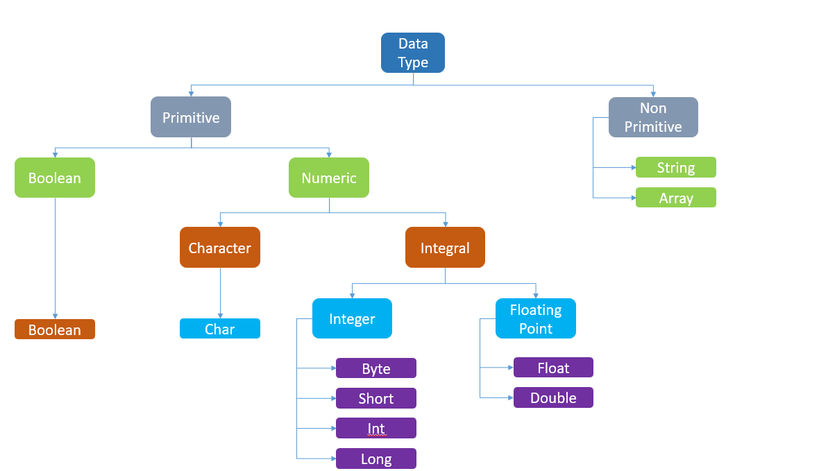
Data types in Java

Slide 13
Comparison operators for Different Data types
String - use .equals(), .equalsIgnoreCase(), .compare()
Object - use .equals(), .equalsIgnoreCase(), .compare()
Int – use ==, !=, <=, >=, <, >
Boolean – use == and !=

Slide 14
Methods
A Java method is a collection of statements that are grouped together to perform an operation. When you call the System.out.println method, for example, the system actually executes several statements in order to display a message on the console.
modifier returnValueType methodName(list of parameters) {
// Method body;
}
Calling a Method: To use a method, you have to call or invoke it. There are two ways to call a method; the choice is based on whether the method returns a value or not.
Ex: int larger = max(30, 40); // this method returns int
captureScreenshot();// return type is void

Slide 15
Methods contd…
In order to call a method from a different class, you need to create an instance of the class.
For example: to use a method from Class2 in Class 1
Class2 class2Object = new Class2();
class2Object.getSystemDate();
Passing Parameters by Values: When calling a method, you need to provide arguments, which must be given in the same order as their respective parameters in the method specification.
public static void nPrintln(String message, int n) {
for (int i = 0; i < n; i++){
System.out.println(message);
}
}

Slide 16
Method OverLoading
Method Overloading is when two methods have the same name but different parameter lists within one class.
Example:
public void captureScreenshot(Object captureObject){
-----
------
}
Overloaded Method:
public void captureScreenshot(Object captureObject, int lineNumber, String systemDate){
}

Slide 17
Conditional Statements
Java supports two selection statements: if and switch.
These statements allow you to control the flow of your program’s execution based upon conditions known only during run time.
The if statement is Java’s conditional branch statement. It can be used to route program execution through two different paths.
Syntax :
if (condition){
statement1;
}
The switch statement is Java’s multiway branch statement.
switch (expression) {
case value 1 :
statement 1 ; break;
case value 2 :
statement 2 ; break;
...
}

Slide 18
Loops and Statements
Java has very flexible three looping mechanisms. You can use one of the following three loops:
while Loop
Syntax: while(count < 4)
{
}
do...while Loop
Syntax: do{
}while(count <4)
for Loop
Syntax: for(int i=0; i<count; i++){
}
ForEach for(int i:arr)
{
}

Slide 19
Loops and Statements contd…
Java supports three jump statements: break, continue, and return. These statements transfer control to another part of your program.
Break Statement:
This statement is used to jump out of a loop.
On encountering a break statement within a loop, the execution continues with the next statement outside the loop.
The remaining statements which are after the break and within the loop are skipped.
Continue Statement:
This statement is used only within looping statements.
When the continue statement is encountered, the next iteration starts.
The remaining statements in the loop are skipped. The execution starts from the top of loop again.

Slide 20
Loops and Statements contd…
Return Statement:
The return statement is used to explicitly return from a method.
That is, it causes program control to transfer back to the caller of the method.
The return statement immediately terminates the method in which it is executed.
Return statement should be the last statement in a method

Slide 21
Wrapper class
Wrapper classes in Java are used to convert primitive datatypes into objects and vice-versa.
Autoboxing and unboxing features convert primitives into objects and objects into primitives automatically.
Since Java is an object-oriented language, we will have scenarios to use primitive data types as objects for example in collections.

Slide 22
Wrapper class
Primitive | Wrapper
boolean | Boolean
char | Character
byte | Byte
short | Short
int | Integer
long | Long
float | Float
double | Double

Slide 23
Autoboxing and Unboxing
Autoboxing
int a=20;
Integer i=Integer.valueOf(a);//converting int into Integer explicitly
Integer j=a;//autoboxing, compiler will write Integer.valueOf(a) internally
System.out.println(a+" "+i+" "+j);
Unboxing
Integer a=new Integer(3);
int i=a.intValue();//converting Integer to int explicitly
int j=a;//unboxing, now compiler will write a.intValue() internally
System.out.println(a+" "+i+" "+j);

Slide 24
Access Modifiers
Access modifiers specifies who can access them.
There are three access modifiers used in java. They are public, private and protected
Access Modifiers | Same Class | Same Package | Sub Class | Other Packages
public | Yes | Yes | Yes | Yes
protected | Yes | Yes | Yes | No
private | Yes | No | No | No
No Access Modifier | Yes | Yes | No | No

Slide 25
Constructors in Java
Constructor is a code block like a method but without a return type.
Constructors are called when an instance of class is created.
If no constructors are included in a class, Java creates a default constructor without parameters.
Rules for creating a constructor:
Constructor name and class name must be same
A constructor cannot have return type
A constructor cannot be abstract, static or final

Slide 26

Encapsulation in Java
It is the binding of data and methods that work on that data in a single unit.
Encapsulation is achieved by declaring the instance variables of a class as private. Public methods called getters and setters are defined to allow outside access to the instance variables.
Notes:
Use of encapsulation:
Data member are not directly modified
We can set the properties on what data to accept in the setter methods.
Ex: Say there is age property and it is of the type int
User can pass a negative value say -5 which is of the type int but not a valid age.
We can define these rules in setter method to accept only positive values for date.
// Person Class
class Person {
// Encapsulating the name and age
// only approachable and used using
// methods defined
private String name;
private int age;
public String getName() { return name; }
public void setName(String name) { this.name = name; }
public int getAge() { return age; }
public void setAge(int age) { this.age = age; }
}
// Driver Class
public class Main {
// main function
public static void main(String[] args)
{
// person object created
Person person = new Person();
person.setName("John");
person.setAge(30);
// Using methods to get the values from the
// variables
System.out.println("Name: " + person.getName());
System.out.println("Age: " + person.getAge());
}
}

Slide 27
Inheritance
Inheritance is an oops feature that allows one class to inherit/access another class's features(fields and methods).
Inheritance is useful in,
Code reusability
Method overriding
Abstraction

Slide 28
Example of Inheritance
Create Parent Class Bicycle with methods
Create a subclass say mountain bike extending bicycle.
Add methods and instance variables in child class.
Override methods from super class
Notes:
Class Bicycle
------------------
public class Bicycle {
public int gear;
public int speed;
// the Bicycle class has one constructor
public Bicycle(int gear, int speed)
{
this.gear = gear;
this.speed = speed;
}
// the Bicycle class has three methods
public void applyBrake(int decrement)
{
speed = speed - decrement;
}
public void speedUp(int increment)
{
speed = speed +increment;
}
// toString() method to print info of Bicycle
public String toString()
{
return ("No of gears are " + gear + "\n"
+ "speed of bicycle is " + speed);
}
---------Class mountain bike-------------------
public class MountainBike extends Bicycle{
int seatHieght;
public MountainBike(int gear, int speed, int seatHieght) {
super(gear, speed);
this.seatHieght = seatHieght;
}
@Override public String toString()
{
return (super.toString() + "\nseat height is "
+ seatHieght);
}
}

Slide 29
Polymorphism
Java Polymorphism is the ability of a message to be displayed in more than one form.
Polymorphism allows the user to define one interface and have multiple implementations.
There are two types of polymorphism
Compile-time Polymorphism (Overloading)
Run-time Polymorphism (Overriding)

Slide 30
Abstraction & Interface
Abstraction is a process of hiding the implementation details and showing only functionality to the user.
Another way, it shows only essential things to the user and hides the internal details, for example, sending SMS where you type the text and send the message. You don't know the internal processing about the message delivery.
abstract class Bike{
abstract void run();
}
class Honda extends Bike{
void run(){System.out.println("running safely");}
public static void main(String args[]){
Bike obj = new Honda();
obj.run();
}
}
Notes:
A class which is declared as abstract is known as an abstract class. It can have abstract and non-abstract methods. It needs to be extended and its method implemented. It cannot be instantiated.
Points to Remember
An abstract class must be declared with an abstract keyword.
It can have abstract and non-abstract methods.
It cannot be instantiated.
It can have constructors and static methods also.

Slide 31
Interface
An interface in java is a blueprint of a class. It has static constants and abstract methods.
In other words, you can say that interfaces can have abstract methods and variables. It cannot have a method body.
Multiple inheritance is not supported through class in java, but it is possible by an interface
interface printable{
void print();
}
class A6 implements printable{
public void print(){System.out.println("Hello");}
public static void main(String args[]){
A6 obj = new A6();
obj.print();
}
}
Notes:
Multiple Inheritance
interface Printable{
void print();
}
interface Showable{
void show();
}
class A7 implements Printable,Showable{
public void print(){System.out.println("Hello");}
public void show(){System.out.println("Welcome");}
public static void main(String args[]){
A7 obj = new A7();
obj.print();
obj.show();
}
}
----------------------------------------
interface Drawable {
void draw();
}
interface Movable {
void moveTo(int x, int y);
}
class Circle implements Drawable, Movable {
double pi = 3.14;
int radius;
Circle(int radius) {
this.radius = radius;
}
@Override public void draw()
{
System.out.println("Circle has been drawn ");
}
@Override public void moveTo(int x, int y)
{
System.out.println("Circle has been moved to x = " + x + " and y = " + y);
}
}
public class Main
{
public static void main(String[] args)
{
Circle circle = new Circle(2);
circle.draw();
circle.moveTo(2, 4);
}
}

Slide 32
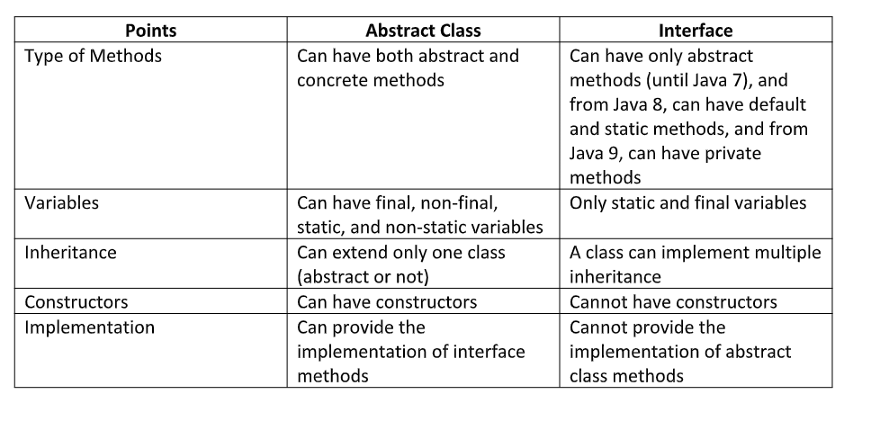
Abstraction Vs Interface

Slide 33
Solving diamond problem with interface
Diamond Problem is a problem faced during Multiple Inheritance in Java.
Multiple inheritance is when a child class is inherits the properties from more than one parents
Dimond problem occurs when the methods for the parents are same (Method name and parameters are exactly the same) then child gets confused about which method will be called

Slide 34
Final Keyword
The final keyword in java is used to restrict the user.
It can be used for
Classes
Methods
Variables
If you make any variable as final, you cannot change the value of final variable.
If you make any method as final, you cannot override it.
If you make any class as final, you cannot extend it.

Slide 35
Static Keyword
Static keywords are mainly used for memory management.
Static keywords is used for variables to refer the common properties which does not change for each object.
Ex: Company name for employees
Instance variables are created everytime object is created for the class.
In the case of Static variables, same copy is shared by all objects.
Notes:
class Counter2{
static int count=0;//will get memory only once and retain its value
Counter2(){
count++;//incrementing the value of static variable
System.out.println(count);
}
public static void main(String args[]){
//creating objects
Counter2 c1=new Counter2();
Counter2 c2=new Counter2();
Counter2 c3=new Counter2();
}

Slide 36
Static Methods
A static method belongs to the class rather than the object of a class.
A static method can be invoked without the need for creating an instance of a class.
A static method can access static data member and can change the value of it.
The static method can not use non static data member or call non-static method directly.
this and super cannot be used in static context.

Slide 37
Java.lang.Object
Object class is present in java.lang package.
Every class in Java is directly or indirectly derived from the Object class.
If a class does not extend any other class then it is a direct child class of Object and if extends another class then it is indirectly derived.
Object class methods are available to all Java classes.

Slide 38
Java.lang.Object
clone()
getClass()
wait()
hashCode()
Object Class
finalize()
equals()
notify()
toString()
notifyAll()
Notes:
hashCode() - For every object, JVM generates a unique number which is a hashcode. It returns distinct integers for distinct objects.

Slide 39
Passing Objects as parameters
In Java, When a primitive type is passed to a method ,it is done by use of call-by-value . Objects are implicitly passed by use of call-by-reference.
Objects in java are reference variables, so for objects a value which is the reference to the object is passed. Hence the whole object is not passed but its referenced gets passed. All modification to the object in the method would modify the object in the Heap.
Notes:
class Add {
int a;
int b;
Add(int x, int y) // parametrized constructor
{
a = x;
b = y;
}
void sum(Add A1) // object 'A1' passed as parameter in function 'sum’
{
int sum1 = A1.a + A1.b;
System.out.println("Sum of a and b :" + sum1);
}
}
public class Main {
public static void main(String arg[]) {
Add A = new Add(5, 8); /* Calls the parametrized constructor with set of parameters*/
A.sum(A);
}
}

Slide 40
Arrays
Group of variables of the same data type
Arrays are declared as
type var_name[]
or
type[] var_name
When an array is declared, only a reference of an array is created. To create or give memory to the array, we make use of ‘new’ keyword.
int[] firstArray = new int[20];
If the values of the array is already know,
int[] firstArray = new int[]{1,2,3,4,5,6,7};

Slide 41
Multidimensional Arrays
Multidimensional arrays are arrays of arrays with each element of the array holding the reference of other arrays.
Syntax: int[][] arr2 = new int[3][3];
Declaring a 2 dimensional array
Int arr[][] = {{1,2,3},{3,4,5},{6,7,8}}
0 1 2
1
0
arr
2

Slide 42
Array of Objects
An array of objects is created like an array of primitive-type data items
Syntax: Cars[] carArray = new Cars[5];
Class Students()
{
int roll_num;
String name;
Students(int rNum, String sName){
roll_num = rNum
sName = Name;
}
main
{
Students[] arr = new Students[5];
arr[0] = new Students[1,”John”];
arr[1] = new Students[2,”Peter”];
….
….
//To Print
arr[i[.roll_num;
arr[i].name;
}

Slide 43
Arrays Utility Class
The Arrays class in java.util package is a part of the Java Collection Framework.
This class provides static methods to dynamically create and access Java arrays.
They are useful in
Filling an array with a particular value
Sort Arrays
Search Arrays
Compare Arrays etc..

Slide 44
Commonly used methods
Methods | Purpose | Syntax
asList() | Converts to List | Arrays.asList(arr1);
binarySearch() | Uses binary search to search for an element and returns the index. | Arrays.binarySearch(arr1,10);
equals() | Compares two arrays and returns true or false | Arrays.equals(intArr, intArr1)
copyOf(originalArray, newLength) | Creates copy of an array by padding/truncating based on the length | Arrays.copyOf(intArr, 10)
sort() | Sorts the original array | Arrays.sort(arr1);
misMatch(arr1,arr2) | Returns the index of first mismatch | Arrays.mismatch(intArr, intArr1)
toString() | Converts the array to string and will be displayed as [10, 20, 15, 22, 35] | Arrays.toString(intArr)

Slide 45
String Class
Strings are the type of objects that can store the character of values and in Java, every character is stored in 16 bits i,e using UTF 16-bit encoding. A string acts the same as an array of characters in Java.
String are immutable i,e. they cannot be changed once created.

Slide 46
String Methods
length() – returns the length of the string
charAt(index) – returns the character at specified index
substring(index) – returns the substring from mentioned index
concat – concatenates 2 strings
indexOf() – returns the index of substring. Returns -1 if not found
equals() – compares 2 strings and returns true or false

Slide 47
String Methods
compareTo(S1,S2) – Compares 2 strings and returns -1,0 or 1
toLowerCase and toUpperCase
Trim() – removes extra white spaces
Replace(old char, new char)

Slide 48
String Buffer
StringBuffer is a class in Java that represents a mutable sequence of characters.
It provides an alternative to the immutable String class, allowing you to modify the contents of a string without creating a new object every time.
They are efficient especially when we are changing the value of a string multiple times.
Notes:
StringBuffer sb=new StringBuffer("Hello ");
sb.append("Java");

Slide 49
Methods of String Buffer
append(“”)
Insert(index, “”);
Replace(startingIndex,lastIndex,””);
delete(startingIndex,lastIndex);
Reverse()

Slide 50
String Builder
StringBuilder is very much similar to the StringBuffer class, as both of them provide an alternative to String Class by making a mutable sequence of characters.
StringBuilder class differs from the StringBuffer class on the basis of synchronization
For single thread, it is recommended to use String Builder as it is faster than stringBuffer.
Notes:
StringBuilder sb=new StringBuilder("Hello ");

Slide 51
RegEx
Matcher and Patter class
Pattern p = Pattern.compile(".s");//. represents single character
Matcher m = p.matcher("as");
boolean b = m.matches();
//2nd way
boolean b2=Pattern.compile(".s").matcher("as").matches();

Slide 52
Reg Ex
System.out.println(Pattern.matches(".p", "ap"));
System.out.println(Pattern.matches(".s", "mk"));
System.out.println(Pattern.matches(".s", "mst"));
System.out.println(Pattern.matches(".s", "amms"));
System.out.println(Pattern.matches("..s", "mas"));

Slide 53
RegEx Charecters
[abc] – any character in a, b or c
[^abc] - Any character except a, b, or c (negation)
[a-zA-Z] - a through z or A through Z, inclusive
[a-d[m-p]] - a through d, or m through p
[a-z&&[^bc]] - a through z, except for b and c:
[a-z&&[^m-p]] - a through z, and not m through p
--------------------------------------------------------------------
System.out.println(Pattern.matches("[amn]", "abcd"));
System.out.println(Pattern.matches("[amn]", "a"));
System.out.println(Pattern.matches("[amn]", "ammmna"))

Slide 54
RegEx Quantifiers
X? - X occurs once or not at all
X+ - X occurs once or more times
X* - X occurs zero or more times
X{n} - X occurs n times only
X{n,} - X occurs n or more times
X{y,z} - X occurs at least y times but less than z times

Slide 55
RegEx Quantifiers
System.out.println(Pattern.matches("[amn]?", "a"));
System.out.println(Pattern.matches("[amn]?", "aaa"));
System.out.println(Pattern.matches("[amn]?", "aazzta"));
System.out.println(Pattern.matches("[amn]?", "am"));
System.out.println(Pattern.matches("[amn]+", "a"));
System.out.println(Pattern.matches("[amn]+", "aaa"));
System.out.println(Pattern.matches("[amn]+", "aammmnn"));
System.out.println(Pattern.matches("[amn]+", "aazzta"));

Slide 56
RegEx examples
System.out.println(Pattern.matches("[a-zA-Z0-9]{6}", "arun32"));
System.out.println(Pattern.matches("[a-zA-Z0-9]{6}", "kkvarun32"));
System.out.println(Pattern.matches("[a-zA-Z0-9]{6}", "JA2Uk2"));
System.out.println(Pattern.matches("[a-zA-Z0-9]{6}", "arun$2"));

Slide 57
Regex - numbers
System.out.println(Pattern.matches("[789]{1}[0-9]{9}", "9953038949"));
System.out.println(Pattern.matches("[789][0-9]{9}", "9953038949"));
System.out.println(Pattern.matches("[789][0-9]{9}", "99530389490"));
System.out.println(Pattern.matches("[789][0-9]{9}", "6953038949"));
System.out.println(Pattern.matches("[789][0-9]{9}", "8853038949"));

Slide 58
Exception Handling
Exception is a run-time error which arises during the execution of java program.
If the exception object is not handled properly, the interpreter will display the error and will terminate the program.
There are two types of exception handling
Try..catch…finally block
Throws
Syntax of try…catch
try{
…………
}
catch(Exception ex){
…………
}
finally{
}

Slide 59
Exception Handling contd…
If a method is capable of causing an exception that it does not handle, it must specify this behavior so that callers of the method can guard themselves against that exception.
You do this by including a throws clause in the method’s declaration
A throws clause lists the types of exceptions that a method might throw.
Syntax:
public void getDate (String filePath)throws ioexception{
}

Slide 60
Java Best Practices
Dos and Don’ts in Java
Practice | Do’s | Don’t’s
Naming the variables: Always use Camel Case(First word begins with lowercase, First character of subsequent words in uppercase) to name variables and methods. Prefix the first letter of data type being used. | Ex: String sGetResult; connectToDB(); int iNumOfColumns; | Ex: int MYCount; GetScreenText();
Naming Class: Use Pascal case for classes (All words begins with Upper case) | Ex: Class CreateTestResult | Ex: Class createtestresult
Use meaningful Names when declaring variable, methods no matter how lengthy it becomes. It makes it easier to understand the code. Do not use Magic numbers | Ex: int getNumberOfColumns; String confirmationNumber; getSystemDate() | Ex: int a; String s; Method1() int abc = 58; (58 is magic number)

Slide 61
Java Best Practices contd…
Practice | Do’s | Don’s
Include comments in the code: Providing comments where ever necessary in the code makes the code easy to understand for self and others working on the code. Easy to modify. | //Give the required date format String dateFormat = "MM/dd/yyyy"; SimpleDateFormat sdf = new SimpleDateFormat(dateFormat); //get system date and convert it to //required format String sysdate = sdf.format(cal.getTime()); | String dateFormat = "MM/dd/yyyy"; SimpleDateFormat sdf = new SimpleDateFormat(dateFormat); String sysdate = sdf.format(cal.getTime());
Do not leave ‘catch’ block empty: If catch block is left empty, there will be no indication that an exception has occurred | Ex: try{ ….. ………… } catch(Exception ex) { logError(“Error in DB validation “+ex); } | Ex: try{ ….. ………… } catch(Exception ex) { }

Slide 62
Java Best Practices contd…
Practice | Do’s | Don’t’s
Avoid duplicating the code: Write common methods and call those methods in other methods. If a method contains more number of lines, split the methods using refactor option(to refactor a code, select lines of code, right click, select ‘Refactor’ and then click on extract method) Methods should be limited to 20-30 lines | Ex: if(continueLink().exist()) { continueLink().click(); } enterUserCredentials(userID, password); private void enterUserCredentials(String userID, String password) { userIDField().setText(userID); passwordField().setText(password); login.click();} | Ex: if(continueLink().exist()) { continueLink().click(); userIDField().setText(userID); passwordField().setText(password); login.click(); } else { userIDField().setText(userID); passwordField().setText(password); login.click(); }
Declare variables just before use: Declaring variables close to the code where it is used makes it easier to read and maintain | Ex: String getUserID=””; getUserID = userIDBox().getText(); | Ex: String getUserID = “”; ……….. lines of code ……………….. ……………………. getUserID = userIDBox().getText();

Slide 63
Java Best Practices contd…
Practice | Do’s | Don’s
Validate your parameters: It is always good to validate parameters inside a method. For ex: Is the parameter null or is an array length greater than zero etc to avoid exceptions | Ex: If(userID != null) { userIDTextBox().setText(“userID”); } | Ex: userIDTextBox().setText(“userID”);
Close your I/O connections: Always close your Input/Output connections to a file after use in the finally block. | Ex: Connection conn; ……………. ……………………… finally() { conn.close(); }
Use Whitespace in expression and statements: Add single whitespace before and after variables in the expressions and statements | Ex: int verifyCount = 0; if(verifyCount == 0) verifyCount = 1; | Ex: int verifyCount=0; if(verifyCount==0) verifyCount=1;

Slide 64
Java Best Practices contd…
Practice | Do’s | Don’t’s
Indent your code: To indent the code, select the code(Ctrl+A) and press Ctrl+I Do not leave blank lines or white spaces in the code | Ex: for(int i=0;i<rows.length; i++) { if(applData.contains(rows[i])) { rowData = rows[i]; verifyCount++; } else verifyCount--; } | Ex: for(int i=0;i<rows.length; i++) { if(applData.contains(rows[i])) { rowData = rows[i]; verifyCount++; } else verifyCount--; }
Line limitation: Do not initialize a variable with long value in one single line. Limit the number of characters in a line to <100. Ex: If you have a lengthy SQL query, wrap it into multiple lines. This increases the readability. | Ex: String query = “select col1,col2”+ “from ID”; | Ex: String query = “select col1, col2 from ID where……”;

Slide 65
Java Best Practices contd…
Practice | Do’s | Dont’s
Variables Declarations: Do not Declare variables in one single line. If you have say 5 variables, declare it in separate lines | EX: String dbValue = “”; String appValue = “”; String description = “”; String host = “”; | Ex: String dbValue,appValue; String appValue=“”; String host= “”;
Naming the TestScripts: Name your test scripts in below format <TestCase Numer><TestCase Description> | Ex: Test_Case_01CreateRatePlan | EX: TC01

Slide 66
Thank You

